Slide 1
<Autonomous car>
OMAR ASHRAF ABDELMAWGOUD

Slide 2
Components:
1. Ultrasonic HC- SR04.
2. Servo motor.
3. L293D.
4. Motors.
5. Caster wheel.
6. Chassis.

Slide 3
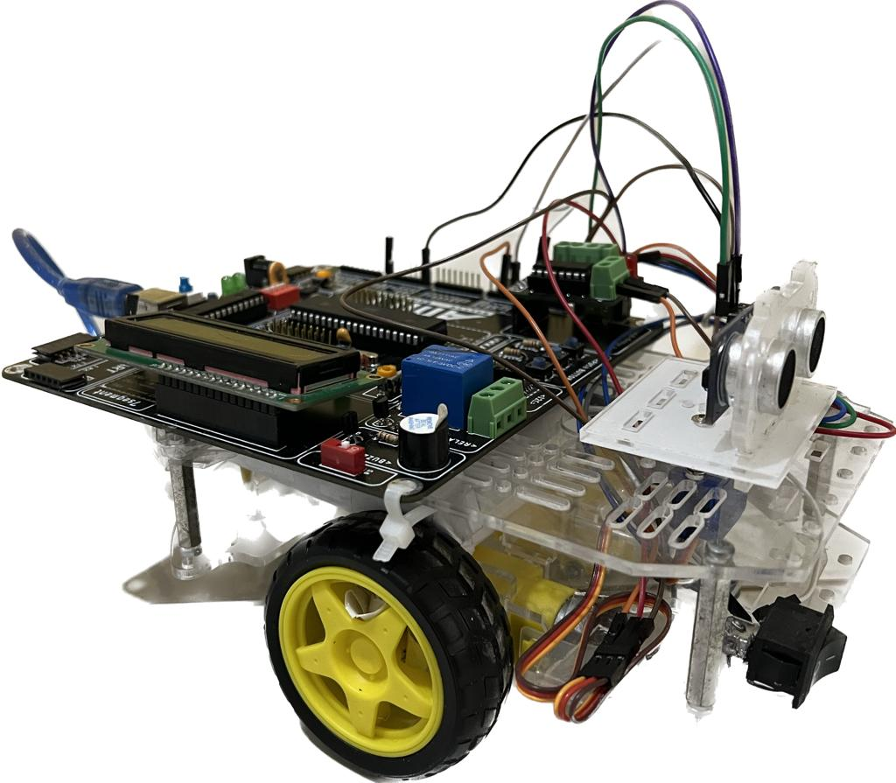
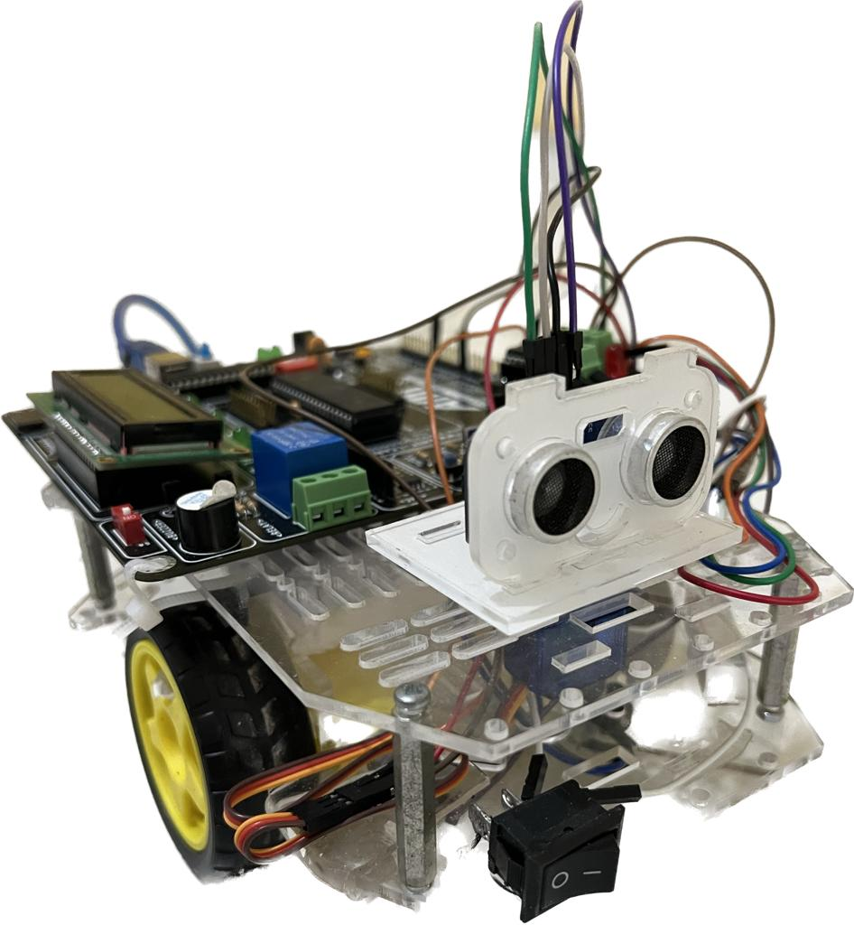
Project Photos:

Slide 4
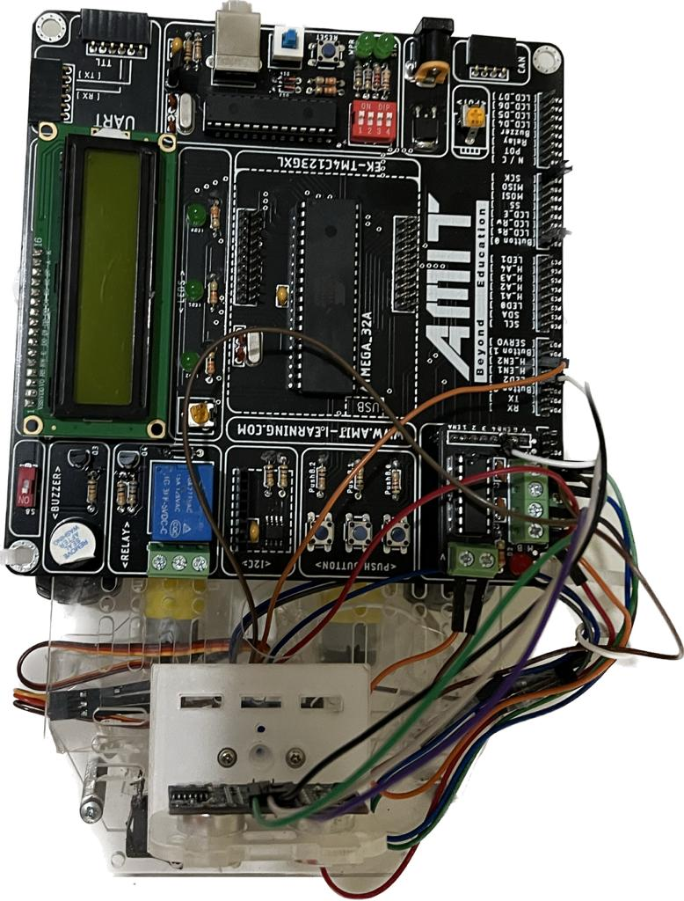

Slide 5
WORK CONCEPT:
1- The car initially moves forward.
2- in case that obstacle is detected (measured distance less than 30cm) :
1- the servo motor moves left subsequently the ultrasonic measures the distance at the
the left of the car.
2- the servo motor moves right subsequently the ultrasonic measures the distance at the
the right of the car.
3-The car compares the two measured distances:
1- in case the left distance is greater than right distance:
the robot moves left and then forward [the direction will be displayed on the lcd].
2-in case the right distance is greater than left distance:
the robot moves right and then forward [the direction will be displayed on the lcd].
3-in case both direction are less than 30 the robot moves back and the turns.

Slide 6
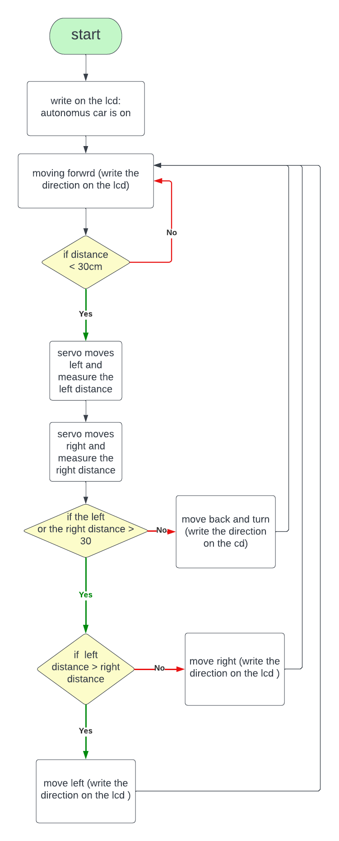
Flow chart:

Slide 7
GitHub link:
https://github.com/omarashraf1233/Autonomus-Car

